Slide 1
Physics 231
Topic: Energy in thermal processes

Slide 2
Current Assignments
Homework Set 9 open - due Thursday, April 7, 11pm
Reading: 11.1-3,11.5.,12.5-6, 12.8 by next week Tuesday, first lecture.

Slide 3
Key Concepts
Heat
Energy change by Heat and Work
Heat capacity
Thermal equilbrium – final temperature when objects with different temperatures come in contact
Phase transition
Heat of vaporization and heat to fusion
Mechanisms of heat transfer: conduction, convection, radiation

Slide 4
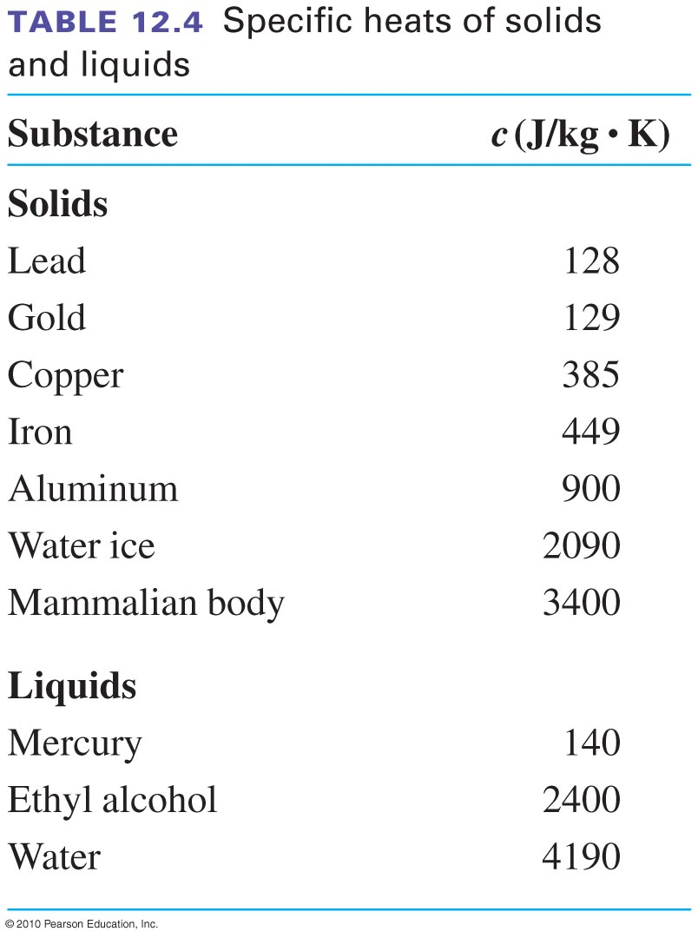
Specific heat capacities
Air: 720 J/kg K (at about 20 deg C)

Slide 5
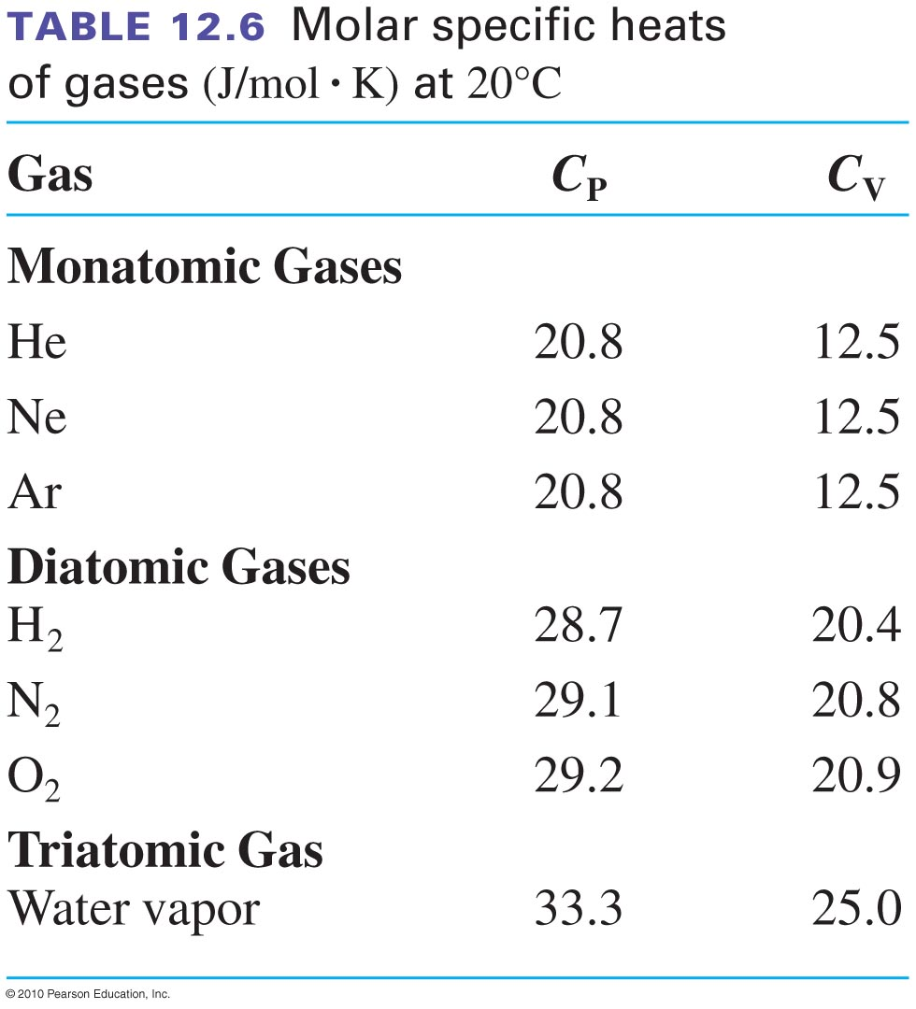
Molar specific heat
This is per mol !!!!!

Slide 6
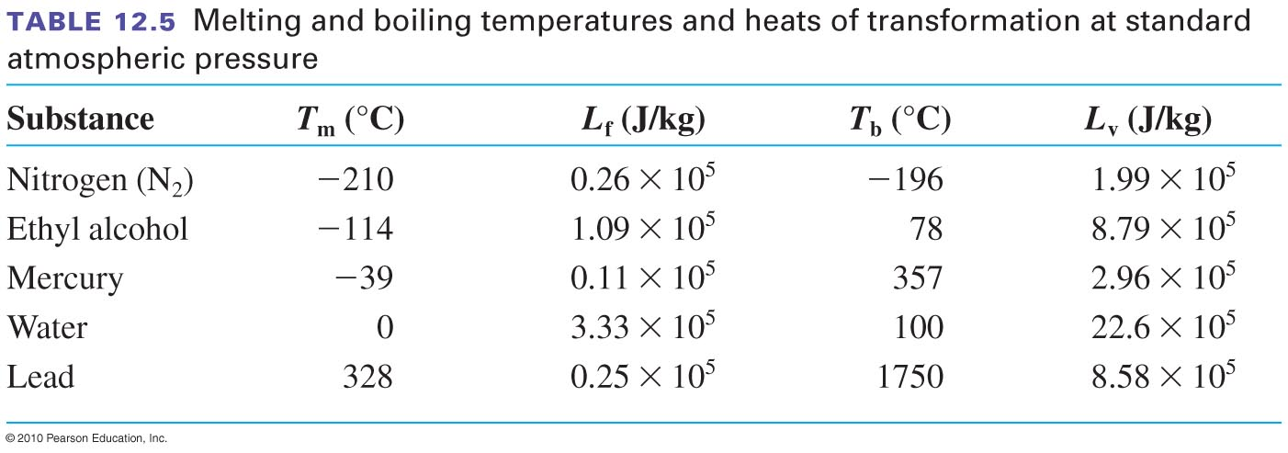
Heats of transformation

Slide 7
Video
http://www.youtube.com/watch?v=1PcnCWZP7l0

Slide 8
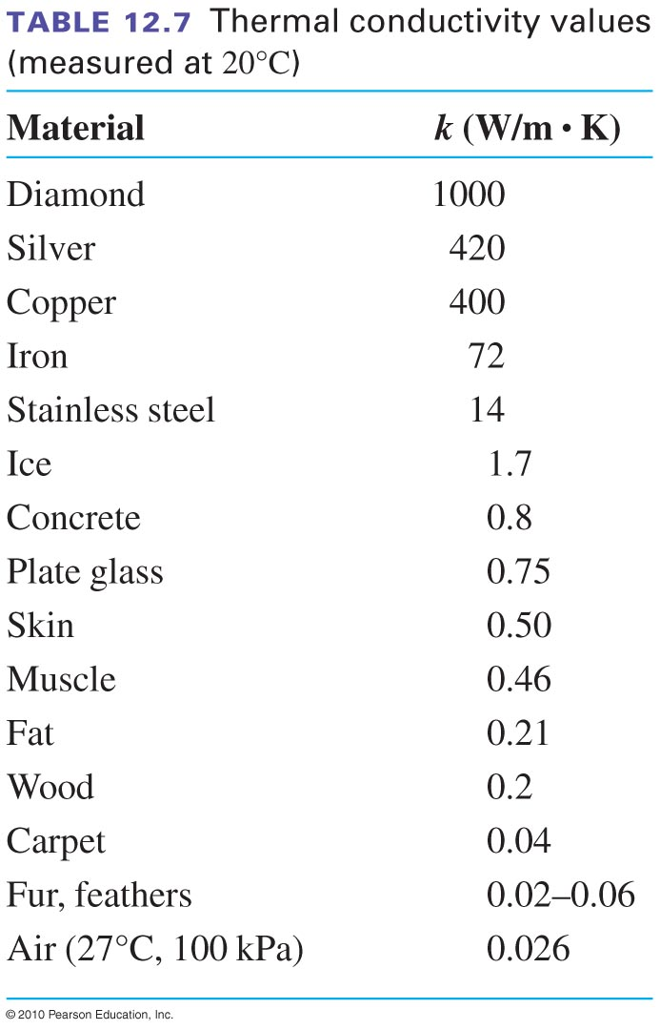
Conductivities

Slide 9
emissivity
Ideal absorber (black body)
e=1
all energy is absorbed
also ideal radiator!
Ideal reflector
e=0
no energy is absorbed

Slide 10
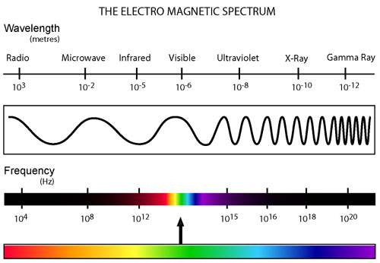

Slide 11
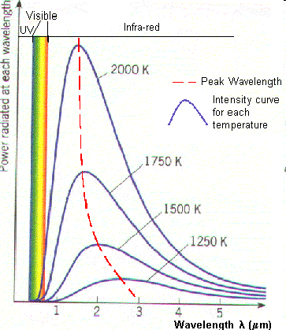
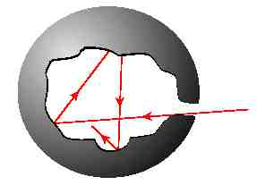
Black body
A black body is an object that absorbs all electromagnetic radiation that falls onto it. They emit radiation, depending on their temperature. If T<700 K, almost no visible light is produced (hence a ‘black’ body).
The energy emitted from a black body: P=σT⁴ with σ=5.67x10⁻⁸ W/m²K⁴
b=2.8977685(51)×10⁻³ mK
Wiens displacement constant
More in PHY232!

Slide 12
Video
http://www.youtube.com/watch?v=1h1wjKqAcqw
http://www.youtube.com/watch?v=fxu1qfwrHu8

